Slide 1
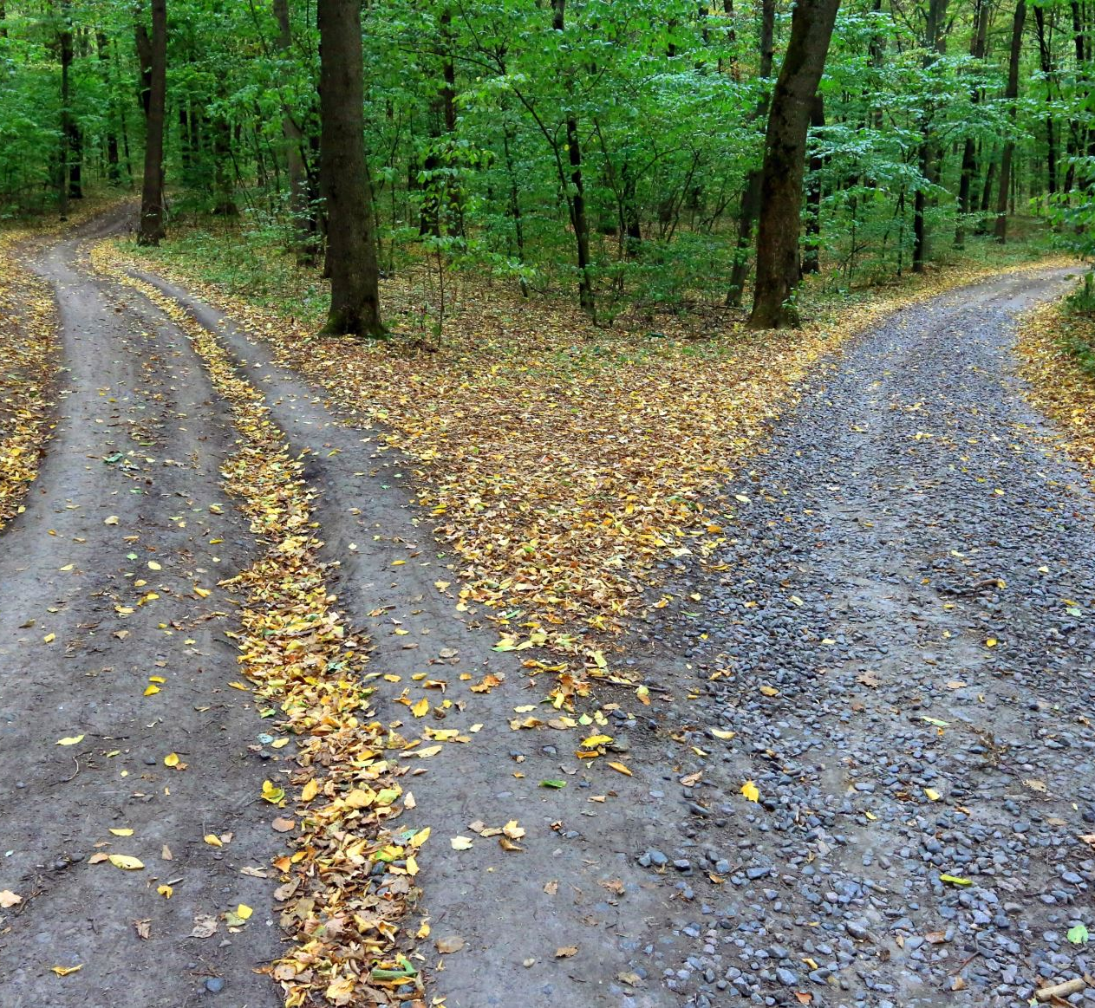
Car Accident Severity Analysis
Sophia Chapman
Coursera Capstone Project

Slide 2
Why Predict Car Accident Severity?
Australia loses over 1200 citizens every year to road deaths
Weather, road conditions and lighting conditions all contribute to accident severity
If an MLA can be produced for weather, road conditions and lighting conditions to predict car accident severity, it can be used by:
  Mapping software to divert traffic away from locations where severe accidents are more likely
  Emergency services responders to ensure emergency responders are situated closer to locations where severe accidents are more likely
  Policy makers to direct policy focus
  Road users to identify when it may be advisable to avoid non-essential journeys

Slide 3
Data Acquisition and Cleaning
Data has been obtained from Seattle Department of Transport from 2004 - 2018
  Australian data is not of the same detail or quality – but successful MLA may be used as impotence to obtain Australian data
Elements with missing weather, lighting conditions or road conditions were removed
  167,427 elements total with no duplicate elements
Lighting conditions, weather and road conditions were numerically encoded
  Potential confounding factors like speeding, driver distraction and intoxication were encoded as 1 (for Yes) or 0 (for No) to allow sensitivity analysis for MLA
  Some data sample sizes are limited (e.g. partly cloudy weather has 5 elements)
Data is normalised to visualise proportion of severe (Severity 2) vs less severe (Severity 1) crashes

Slide 4
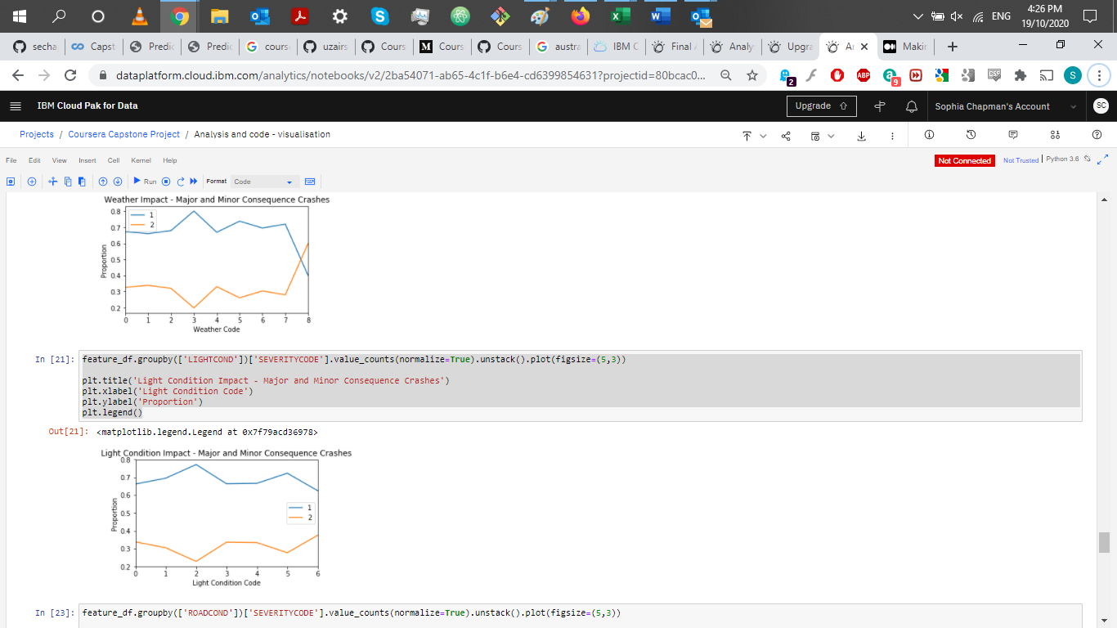
Weather Impact
Clear, Raining and Overcast conditions have similar proportions of severe accidents
  Raining and Overcast have slightly higher likelihood of severe accident, but difference is small
Snowing conditions have lowest proportion of severe accident
  Sample size is statistically significant
  This may be counterintuitive to expectations for many stakeholders
“Partly Cloudy” data (5 elements – group 8) is not statistically significant
Weather Condition | Encoded Value
Clear | 0
Raining | 1
Overcast | 2
Snowing | 3
Fog/Smog/Smoke | 4
Sleet/Hail/Freezing Rain | 5
Blowing Sand/Dirt | 6
Severe Crosswind | 7
Partly Cloudy | 8

Slide 5
Lighting Condition Impact
Other than “Dark – Unknown Lighting”, “Daylight” had the highest proportion of severe crashes
  “Dark – Unknown lighting” is a relatively small sample (<50 elements out of >167,000) and is not statistically significant
“Dark – No street lights” had the lowest proportion of severe crashes, followed by “Dark – Street Lights off”
  Again, this may be counterintuitive for many stakeholders – further investigation is required as to why this is
Light Condition | Encoded Value
Daylight | 0
Dark – Street Lights On | 1
Dark – No Street Lights | 2
Dusk | 3
Dawn | 4
Dark – Street Lights Off | 5
Dark – Unknown Lighting | 6

Slide 6
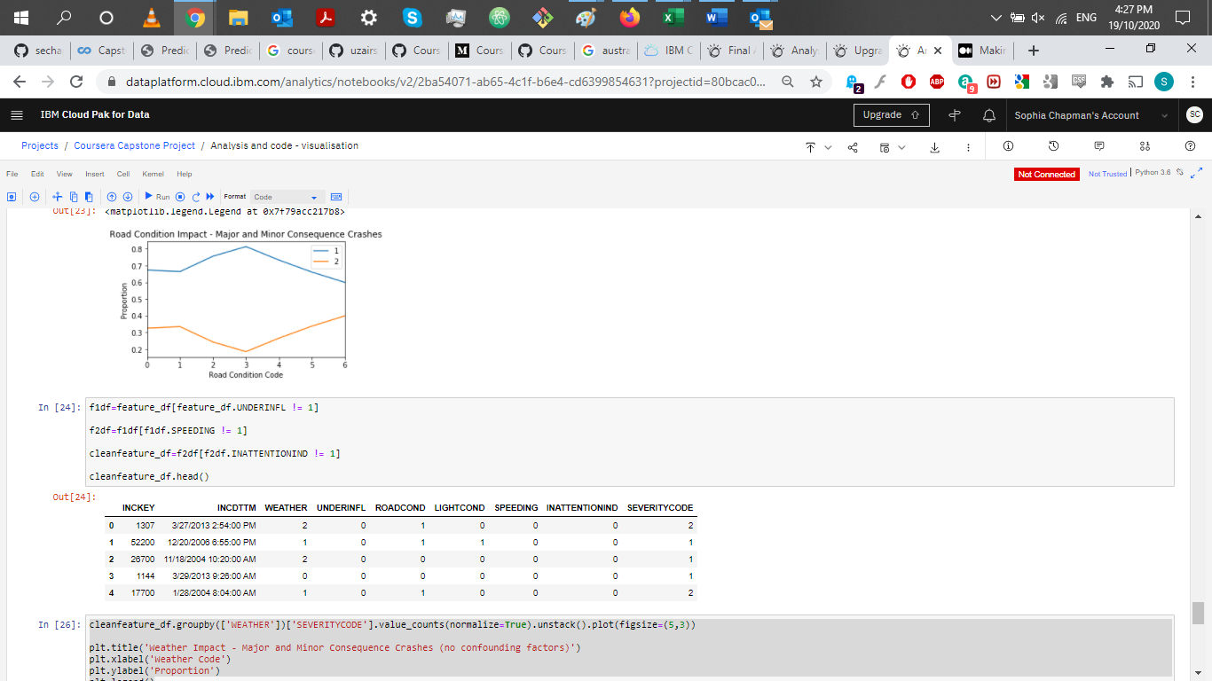
Road Condition Impact
Wet conditions had the highest proportion of severe crashes, followed closely by Dry conditions
Ice and Snow/Slush had the lowest proportion of severe crashes
Oil, Standing water, and Sand/Mud/Dirt did not have enough data points to be considered statistically significant
Road Condition | Encoded Value
Dry | 0
Wet | 1
Ice | 2
Snow/Slush | 3
Standing Water | 4
Sand/Mud/Dirt | 5
Oil | 6

Slide 7
Machine Learning Algorithms (MLAs)
4 MLAs utilized for this assessment
  K Nearest Neighbour (KNN)
  Support Vector Analysis (SVM)
  Decision Tree
  Logistic Regression
Data split into training subset (20%) and testing subset (80%)
MLAs developed for complete cleaned dataset and subset only of data without speeding, indicators of inattention and driver intoxication
  Speeding, driver inattention and driver intoxication increase the likelihood of a crash being severe in any conditions – analysis was needed to establish whether this impacted MLA accuracy
Accuracy assessed using Jaccard Similarity Score, F1 Score and (for Logistic Regression) Log Loss
False Positive (predicts Severity 2 and actual was severity 1) and False Negative (predicts Severity 1 and actual was severity 2) rates assessed

Slide 8
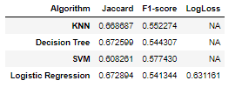
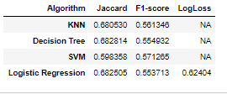
Machine Learning Algorithms - Results
Minimal difference in accuracy between MLAs developed for data sets with and without speeding, intoxication and driver distraction elements
Decision Tree consistently had the best accuracy – but SVM had the lowest false negative rate
  Different stakeholders may have different needs
  Some stakeholders may need to prioritise lower false negative rate over model accuracy
MLA Accuracy Analysis – Including Speeding, Intoxication and Distraction Elements
MLA Accuracy Analysis – Excluding Speeding, Intoxication and Distraction Elements

Slide 9
Conclusions and Next Steps
Although MLA has been developed to determine whether a crash is likely to be severe, its accuracy is limited (Jaccard Similarity Score of 0.67) and is based on the Seattle context
Further data is required to be gathered in the Australian context – MLA may be refined and applied by Australian stakeholders
  Data needs to be gathered until sample sizes for each condition are statistically significant
Qualitative assessment required to understand why some (typically viewed as more dangerous) conditions result in a lower severe crash proportion to ensure policy application does not create complacency leading to a severe crash increase

